Slide 1
CPSC 583 Expert Systems Design Theory
Dr. Anand Panangadan
apanangadan@fullerton.edu

Slide 2
What we will cover today
Introductions
What are Expert Systems?
Where does this fit in the broader AI field?
Course Outline

Slide 3

A bit about myself
Associate Professor
Computer Science Department

Slide 4
Research interests
Applications of machine learning
Transportation
Social network analysis
Text mining
Sensor networks
Classification of time-series

Slide 5
A bit about yourself?
In the next 5 minutes:
Make groups of two
Introduce yourselves to each other
Learn your partner’s name
What they have heard of, or think of AI
Anything else they would like to share
Afterwards:
One group member introduces the other to the class

Slide 6
What is an Expert System?
Definition of Expert Systems
Rules as a knowledge representation technique
The main players in the development team
Structure of a rule-based expert system
Characteristics of an expert system
Following slides are based on “Artificial Intelligence: A Guide to Intelligent Systems” by M. Negnevitsky (Pearson education) and Christel Kempke

Slide 7
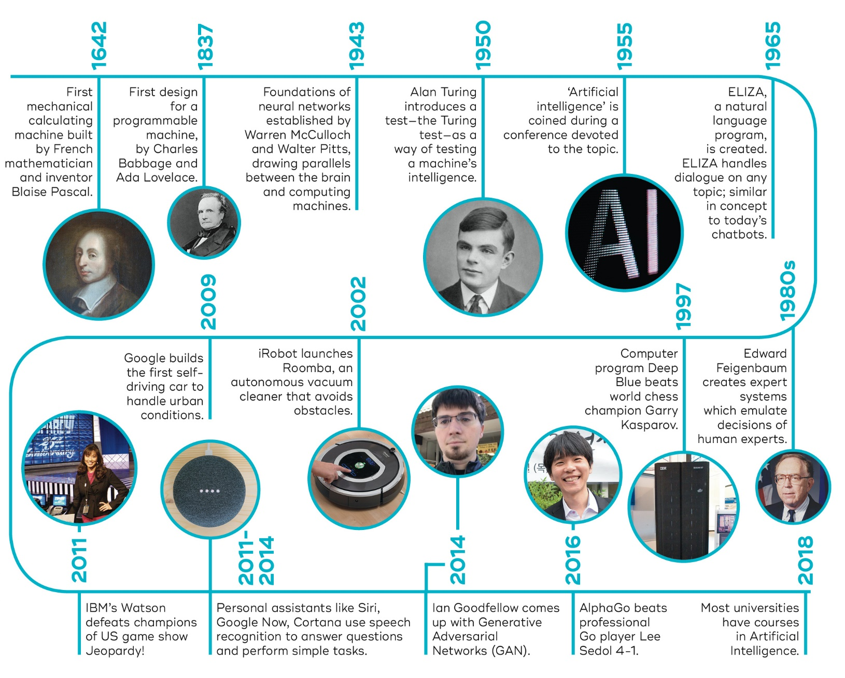
Boolean logic
First order logic
“AI winter”
330BC
1847
1879
1954
Aristotle:
Logic
Bayesian networks
https://qbi.uq.edu.au/files/40697/The-Brain-Intelligent-Machines-AI-timeline.jpg

Slide 8
History
1950 Claude Shannon’s “Programming a Computer for Playing Chess” is the first published article on developing a chess-playing computer program.
1950 Alan Turing publishes “Computing Machinery and Intelligence” in which he proposes “the imitation game” which will later become known as the “Turing Test.”
1956 the First AI Conference at Dartmouth: A program that simulates the machine; How can a computer be programmed to use a language; Neuron networks; Self-improvement through learning and reasoning
1970 The first anthropomorphic robot, the WABOT-1, is built at Waseda University in Japan. It consisted of a limb-control system, a vision system and a conversation system.
1972 MYCIN, an early expert system for identifying bacteria causing severe infections and recommending antibiotics, is developed at Stanford University.
1997 Deep Blue becomes the first computer chess-playing program to beat a reigning world chess champion.

Slide 9
What is an “Expert System” (XPS)?
Edward Feigenbaum
“An intelligent computer program that uses knowledge and inference procedures to solve problems that are difficult enough to require significant human expertise for their solutions.” [Giarratano & Riley 1998]
Also referred to as knowledge-based system

Slide 10
What is knowledge?
Knowledge is a theoretical or practical understanding of a subject or a domain. Knowledge is the sum of what is currently known. Those who possess knowledge are called experts.
A domain expert has deep knowledge (of both facts and rules) and strong practical experience in a particular domain. The area of the domain may be limited. An expert is a skilful person who can do things other people cannot.

Slide 11
Expert Systems
rely on internally represented knowledge to perform tasks
utilize reasoning methods to derive new knowledge
are usually restricted to a specific problem domain
some systems try to capture more general knowledge
General Problem Solver (Newell, Shaw, Simon)
Cyc (Lenat)

Slide 12
Main Components of an XPS
User
Knowledge Base
Expertise
User Interface
Facts / Observations
Knowledge / Rules
Inference Engine
Expertise
Developer

Slide 13
Main XPS Components
knowledge base
contains essential information about the problem domain
inference engine
mechanism to derive new knowledge from the knowledge base and the information provided by the user
user interface
interaction with end users
development and maintenance of the knowledge base

Slide 14
The main players in the development team
the domain expert
the knowledge engineer
the programmer
the end-user

Slide 15
Domain expert
The domain expert is a knowledgeable and skilled person capable of solving problems in a specific area or domain. This person has the greatest expertise in a given domain. This expertise is to be captured in the expert system. Therefore, the expert must be able to communicate his or her knowledge, be willing to participate in the expert system development and commit a substantial amount of time to the project.
The domain expert is the most important player in the expert system development team.

Slide 16
Knowledge engineer (You!)
The knowledge engineer is someone who is capable of designing, building and testing an expert system. He or she interviews the domain expert to find out how a particular problem is solved. The knowledge engineer establishes what reasoning methods the expert uses to handle facts and rules and decides how to represent them in the expert system. The knowledge engineer then chooses some development software or an expert system shell, or looks at programming languages for encoding the knowledge. And finally, the knowledge engineer is responsible for testing, revising and integrating the expert system into the workplace.

Slide 17
Programmer (You!)
The programmer is the person responsible for the actual programming, describing the domain knowledge in terms that a computer can understand. The programmer needs to have skills in symbolic programming in such AI languages as Prolog and also some experience in the application of different types of expert system shells. In addition, the programmer should know conventional programming languages.

Slide 18
End-user
The end-user is a person who uses the expert system after it is developed. The user must not only be confident in the expert system performance but also feel comfortable using it. Therefore, the design of the user interface of the expert system is also vital for the project’s success; the end-user’s contribution here can be crucial.

Slide 19
Early XPS Success Stories
DENDRAL (Feigenbaum, Lederberg, and Buchanan, 1965)
deduce the likely molecular structure of organic chemical compounds from known chemical analyses and mass spectrometry data
MYCIN (Buchanan and Shortliffe, 1972-1980)
diagnosis of infectious blood diseases and recommendation for use of antibiotics
“empty” MYCIN = EMYCIN = XPS shell
PROSPECTOR
analysis of geological data for minerals
discovered a mineral deposit worth $100 million
XCON/R1 (McDermott, 1978)
configuration of DEC VAX computer systems
2500 rules; processed 80,000 orders by 1986; saved DEC $25M a year

Slide 20

“AI system solves geometry questions as well as the average eleven year old”
Called GeoS, it uses a combination of computer vision to interpret diagrams, natural language processing to read and understand text and a geometric solver to achieve 49 percent accuracy on official SAT test questions
The Allen Institute approach has more in common with an earlier generation of artificial intelligence research that relied on logic and reasoning.
Moreover, the Allen Institute researchers said, machine-learning techniques have continued to fall short in areas where humans excel, such as problem solving.

Slide 21
Development of expert systems
strongly influenced by cognitive science
the way humans solve problems
and mathematics / logic
logic and inference

Slide 22
Rules as a knowledge representation technique
The term rule in AI, which is the most commonly used type of knowledge representation, is an IF-THEN structure that relates given information or facts in the IF part to some action in the THEN part. A rule provides some description of how to solve a problem.
Rules are relatively easy to create and understand.
Any rule consists of two parts: the IF part, called the antecedent (premise or condition) and the THEN part called the consequent (conclusion or action).

Slide 23
Example Rules
IF … THEN Rules
Rule: Red_Light
IF the light is red
THEN stop
Rule: Green_Light
IF the light is green
THEN go
antecedent
(left-hand-side)
consequent
(right-hand-side)

Slide 24
Why rules?
Most experts are capable of expressing their knowledge in the form of rules for problem solving.
IF the ‘traffic light’ is green
THEN the action is go
IF the ‘traffic light’ is red
THEN the action is stop

Slide 25
Rules and Humans
rules can be used to formulate a theory of human information processing (Newell & Simon)
rules are stored in long-term memory
temporary knowledge is kept in short-term memory
(external) sensory input triggers the activation of rules
activated rules may trigger further activation (internal input; “thinking”)
a cognitive processor combines evidence from currently active rules
this model is the basis for the design of many rule-based systems (production systems)

Slide 26
Post Production Systems
Production rules were used by the logician Emil L. Post in the early 1940s in symbolic logic
Post’s theoretical result:
any system in mathematics or logic can be written as a production system
Basic principle of production rules
a set of rules governs the conversion of a set of strings into another set of strings
these rules are also known as rewrite rules
simple syntactic string manipulation
no understanding or interpretation is required

Slide 27
MYCIN Sample Rule
Human-Readable Format
IF the stain of the organism is gram negative
AND the morphology of the organism is rod
AND the aerobiocity of the organism is gram anaerobic
THEN there is strong evidence (0.8)
that the class of the organism is enterobacteriaceae
MYCIN Format
IF (AND (SAME CNTEXT GRAM GRAMNEG)
(SAME CNTEXT MORPH ROD)
(SAME CNTEXT AIR AEROBIC)
THEN (CONCLUDE CNTEXT CLASS ENTEROBACTERIACEAE TALLY .8)
[Durkin 94, p. 133]

Slide 28
Class work
Consider the problem of deciding which course to take in a university degree program
This decision is typically made by a student (“the domain expert”)
How could this decision making be automated?
What are the facts?
What are the rules?

Slide 29
Main Components of an XPS
User
Knowledge Base
Expertise
User Interface
Facts / Observations
Knowledge / Rules
Inference Engine
Expertise
Developer

Slide 30
Inference Engine Cycle
describes the execution of rules by the inference engine
“recognize-act cycle”
pattern matching
update the agenda (= conflict set)
add rules, whose antecedents are satisfied
remove rules with non-satisfied antecedents
conflict resolution
select the rule with the highest priority from the agenda
execution
perform the actions in the consequent part of the selected rule
remove the rule from the agenda
the cycle ends when no more rules are on the agenda, or when an explicit stop command is encountered
Notes:
Check on update phase – removing rules???

Slide 31
Inference engine cycles via a match-fire procedure

Slide 32
Comparison of expert systems with conventional systems and human experts

Slide 33
Comparison of expert systems with conventional systems and human experts (Continued)

Slide 34
Advantages of rule-based expert systems
Natural knowledge representation. An expert usually explains the problem-solving procedure with such expressions as this: “In such-and-such situation, I do so-and-so”. These expressions can be represented naturally as IF-THEN production rules.
Uniform structure. Production rules have the uniform IF-THEN structure. Each rule is an independent piece of knowledge. The syntax of production rules enables them to be self-documented.

Slide 35
Advantages of rule-based expert systems
Separation of knowledge from its processing.
The structure of a rule-based expert system provides an effective separation of the knowledge base from the inference engine. This makes it possible to develop different applications using the same expert system shell.
Dealing with incomplete and uncertain knowledge.
Most rule-based expert systems are capable of representing and reasoning with incomplete and uncertain knowledge.

Slide 36
Disadvantages of rule-based expert systems
Opaque relations between rules.
Although the individual production rules are relatively simple and self-documented, their logical interactions within the large set of rules may be opaque. Rule-based systems make it difficult to observe how individual rules serve the overall strategy.
Inefficient search strategy.
The inference engine applies an exhaustive search through all the production rules during each cycle. Expert systems with a large set of rules (over 100 rules) can be slow, and thus large rule-based systems can be unsuitable for real-time applications.

Slide 37
Disadvantages of rule-based expert systems
Inability to learn
In general, rule-based expert systems do not have an ability to learn from the experience. Unlike a human expert, who knows when to “break the rules”, an expert system cannot automatically modify its knowledge base, or adjust existing rules or add new ones. The knowledge engineer is still responsible for revising and maintaining the system.

Slide 38
Disadvantages of rule-based expert systems
limited knowledge
“shallow” knowledge
no “deep” understanding of the concepts and their relationships
no “common-sense” knowledge
no knowledge from possibly relevant related domains
“closed world”
the XPS knows only what it has been explicitly “told”
it doesn’t know what it doesn’t know
mechanical reasoning
may not have or select the most appropriate method for a particular problem
some “easy” problems are computationally very expensive
lack of trust
users may not want to leave critical decisions to machines

Slide 39
When (Not) to Use an Expert System
Expert systems are not suitable for all types of domains and tasks
They are not useful or preferable, when …
efficient conventional algorithms are known
the main challenge is computation, not knowledge
knowledge cannot be captured efficiently or used effectively

Slide 40
Syllabus
See Canvas page

